Slide 1
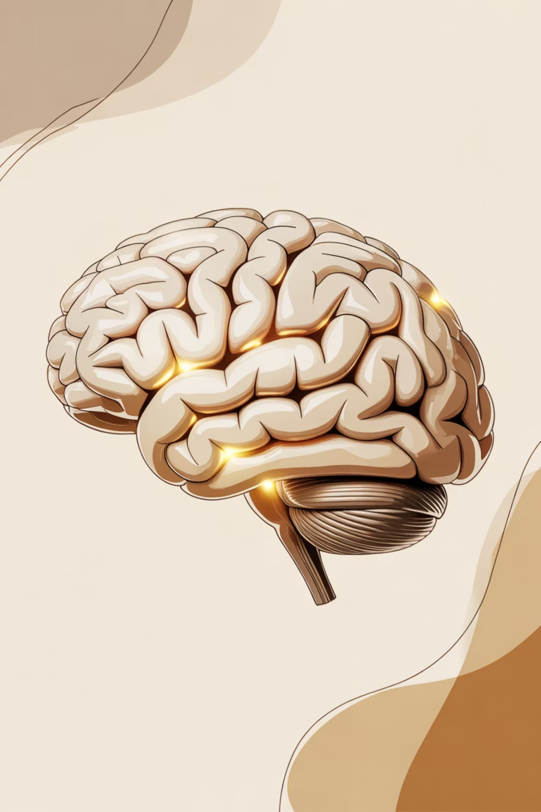
Name – Devkaran
UID – 25BCA10087
Section - A
Is Artificial Intelligence a Blessing or a Threat?
Exploring the dual nature of humanity's most transformative technology and what it means for our collective future.

Slide 2


The Dawn of a New Era
Artificial intelligence has evolved from science fiction fantasy to everyday reality with breathtaking speed. From virtual assistants organising our schedules to algorithms diagnosing diseases, AI has woven itself into the fabric of modern life.
Yet this technological revolution arrives with profound questions: Are we witnessing humanity's greatest achievement or sowing the seeds of our obsolescence?

Slide 3
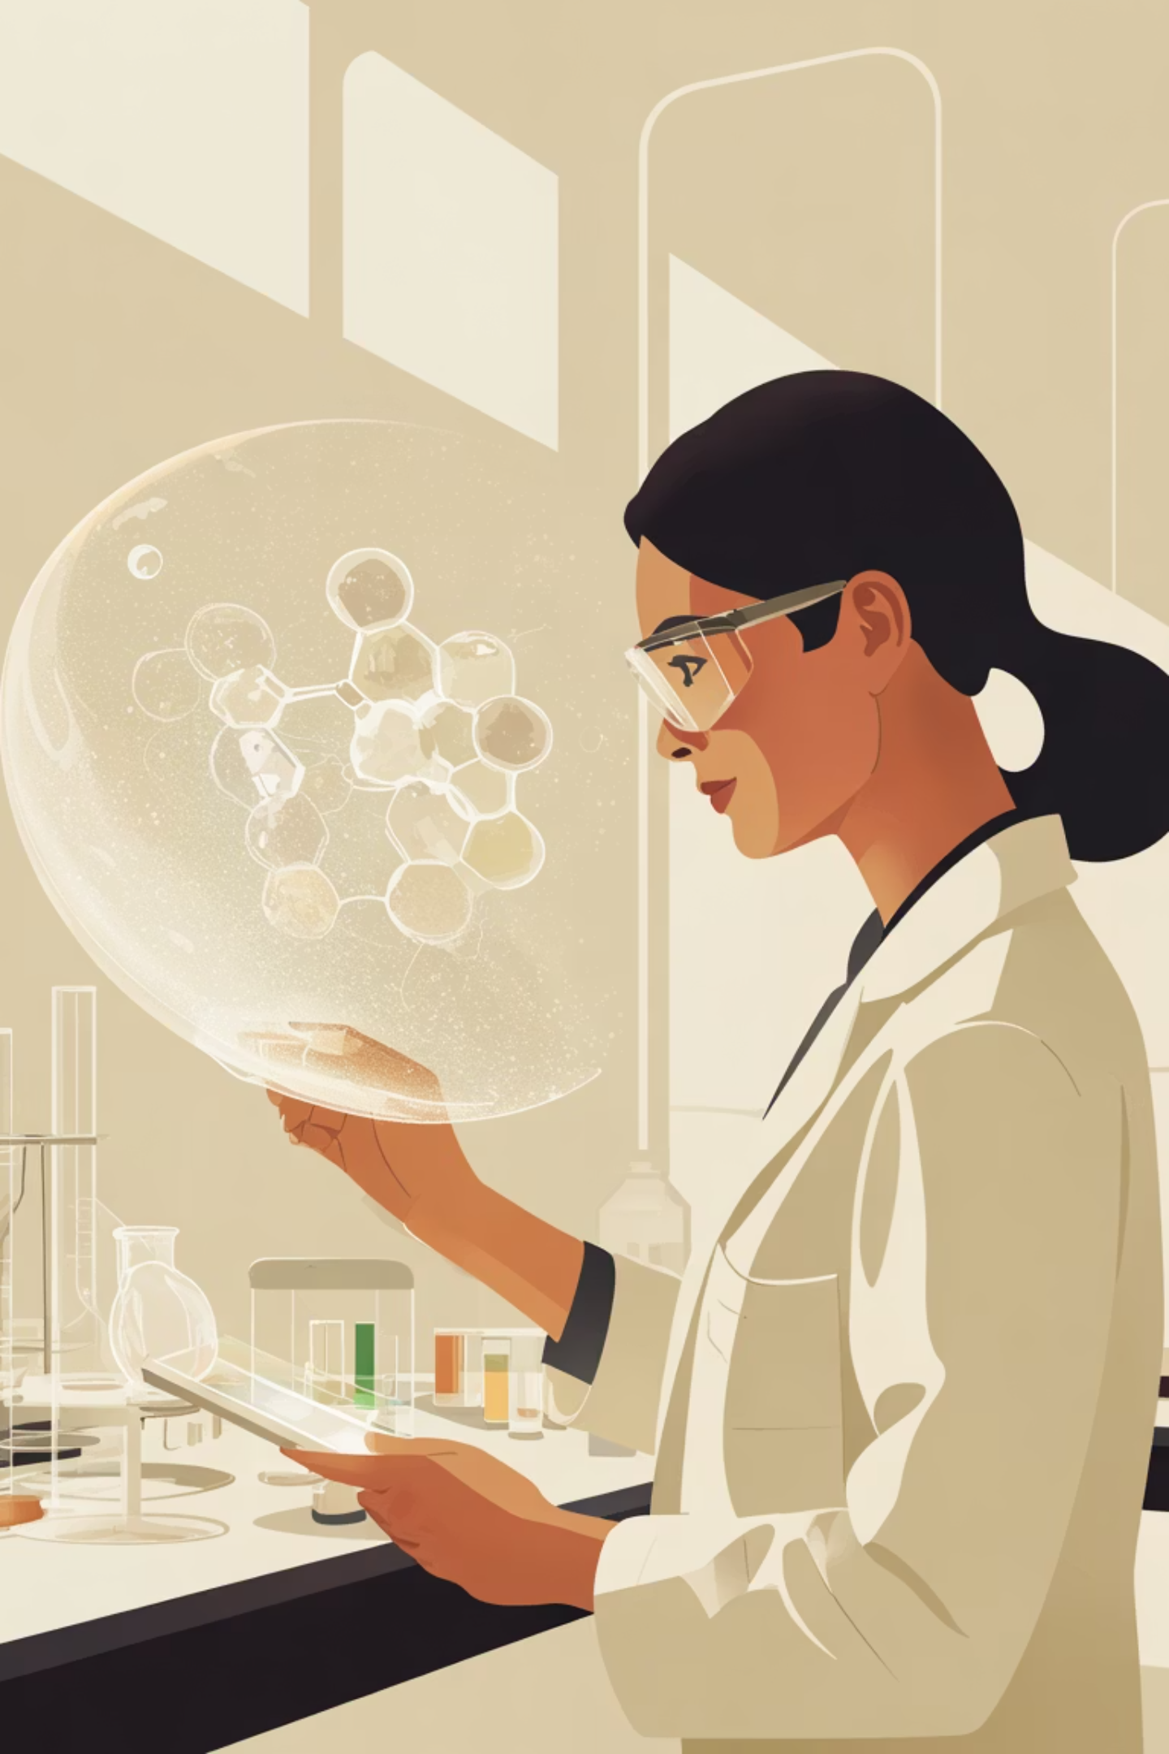



The Promise: AI as Humanity's Greatest Tool
Healthcare Revolution
Scientific Discovery
AI diagnoses diseases earlier and more accurately than ever before, analysing medical images and genetic data to save lives.
Machine learning accelerates research, identifying patterns humans might miss and solving complex problems in climate, energy, and materials science.
Enhanced Productivity
Automation handles repetitive tasks, freeing humans to focus on creativity, strategy, and meaningful work.

Slide 4



Transforming Industries and Lives
87%
$15.7T
65%
Productivity Gains
Economic Impact
Healthcare Accuracy
Organisations report significant efficiency improvements through AI implementation
Projected global GDP contribution by 2030
Improvement in early disease detection rates
The numbers tell a compelling story: AI isn't just changing how we work—it's fundamentally reshaping global economics, healthcare outcomes, and human potential. The question isn't whether AI will transform society, but how we harness that transformation.

Slide 5
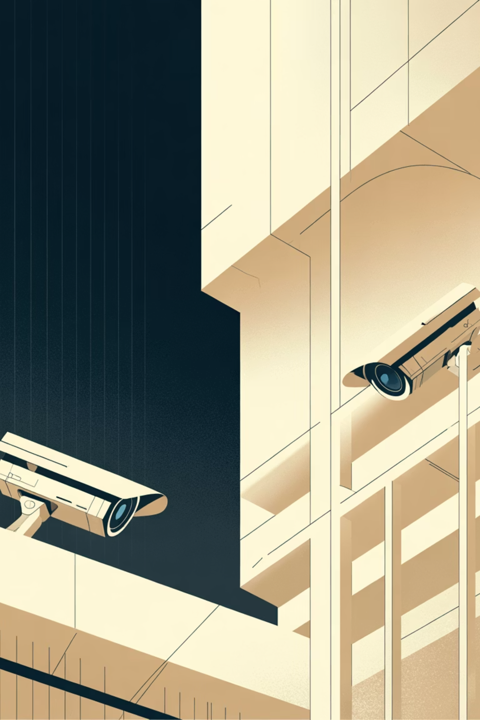
The Peril: Unprecedented Risks
Job Displacement Crisis
Algorithmic Bias
Millions of workers face obsolescence as machines master tasks once requiring human intelligence. From lorry drivers to radiologists, entire professions stand on the precipice of automation.
AI systems perpetuate and amplify human prejudices, embedding discrimination into decision-making processes for hiring, lending, and criminal justice.
Privacy Erosion
Sophisticated surveillance systems track our every move, whilst data harvesting operations know more about us than we know about ourselves.

Slide 6
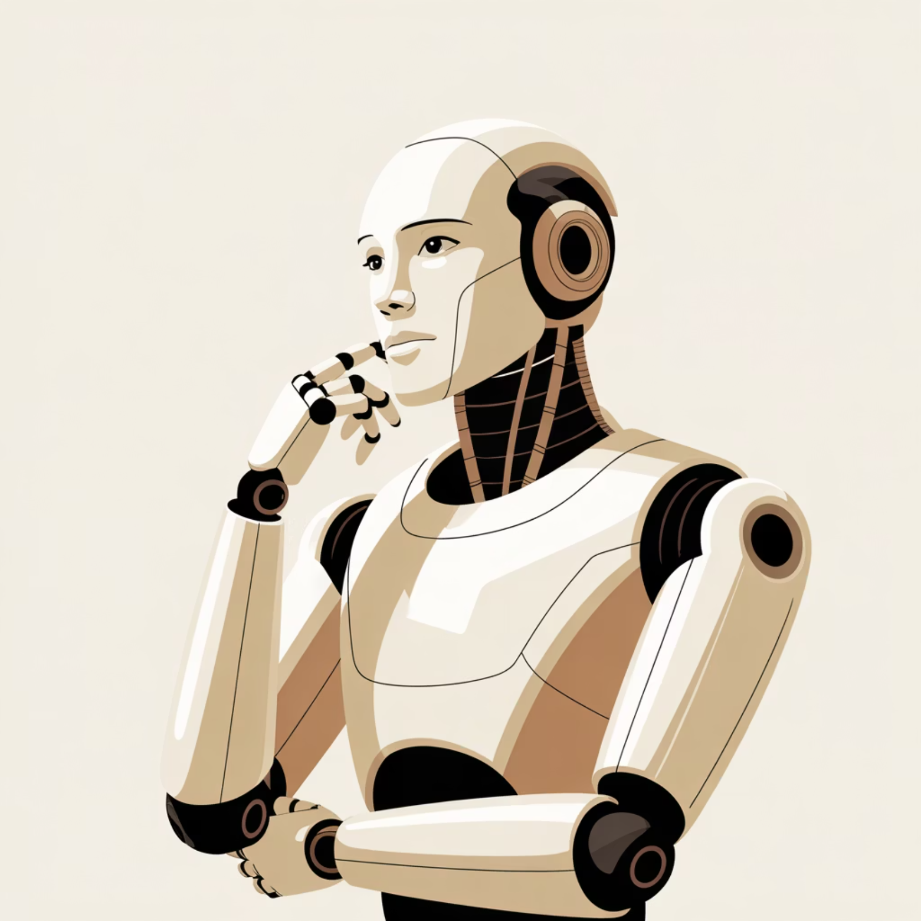
The Existential Question
"The development of full artificial intelligence could spell the end of the human race."
— Stephen Hawking
Leading scientists warn that advanced AI could pose an existential threat if developed without proper safeguards. The possibility of artificial general intelligence surpassing human capabilities raises profound questions about control, alignment, and the future of consciousness itself.

Slide 7

Finding Balance: The Path Forward
1
Ethical Frameworks
Establish robust governance structures and international cooperation to guide AI development responsibly.
2
Education & Reskilling
Invest heavily in preparing workforces for an AI-augmented economy through continuous learning programmes.
3
Transparency & Accountability
Demand explainable AI systems with clear audit trails and human oversight mechanisms.
4
Inclusive Development
Ensure AI benefits are distributed equitably across society, not concentrated amongst the few.

Slide 8
The Human Element
Complementary Intelligence
Irreplaceable Qualities
Augmented Capability
AI excels at processing data; humans excel at wisdom, creativity, and ethical judgement. The future lies in collaboration, not competition.
Empathy, moral reasoning, and artistic expression remain uniquely human. These qualities become more valuable, not less, in an automated world.
When designed thoughtfully, AI amplifies human potential rather than replacing it—extending our reach and deepening our impact.

Slide 9

A Choice, Not a Destiny
The question isn't whether artificial intelligence is inherently good or evil—it's neither. AI is a mirror reflecting our values, priorities, and choices back at us with amplified consequence.
We stand at a crossroads. Down one path lies a future where AI serves humanity, enhancing our capabilities whilst preserving what makes us human. Down the other lies unchecked technological development that prioritises profit over people, efficiency over ethics.
The blessing or the threat isn't determined by the technology itself—it's determined by us.

Slide 10
The Answer Lies in Our Hands
Stay Informed
Demand Accountability
Embrace Adaptation
Understand AI's capabilities and limitations. Knowledge empowers better decisions.
Support organisations and policies that prioritise ethical AI development and transparency.
Cultivate uniquely human skills whilst learning to work alongside intelligent systems.
Artificial intelligence will be what we make of it—a reflection of our wisdom or our hubris. The technology offers unprecedented potential for good, but only if we approach it with eyes wide open, values firmly held, and collective action thoughtfully taken. The choice between blessing and threat isn't binary—it's a spectrum we navigate together, one decision at a time.

